Slide 1

Chapter 4
MGN-502
Personality, Perception,
and Attribution
P. B. NARENDRA KIRAN
ASSISTANT PROFESSOR

Slide 2
Variables Influencing
Individual Behavior
P
The Person
Skills & abilities
Personality
Perceptions
Attitudes
Values
Ethics
E
The Environment
Organization
Work group
Job
Personal life
B
Behavior
B = f(P,E)
1
Notes:
4
4
4
5

Slide 3
Propositions of
Interactional Psychology
Behavior—function of a continuous, multi-directional interaction between person and situation
Person—active in process
  Changed by situations
  Changes situations
People vary in many characteristics
Two situational interpretations
  The objective situation
  Person’s subjective view of the situation

Slide 4
Definition of Personality
Personality - A relatively stable set of characteristics that influences an individual’s behavior
Personality refers to individual differences in characteristic patterns of thinking, feeling and behaving.
In other words the sum of ways in which an individual reacts and interacts with others.
Notes:
6
6
6
6

Slide 5
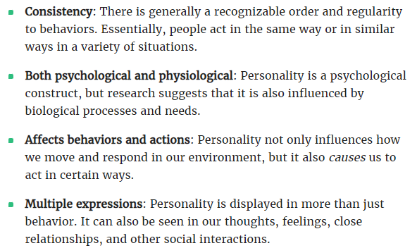
Personality
Notes:
6
6
6
6

Slide 6
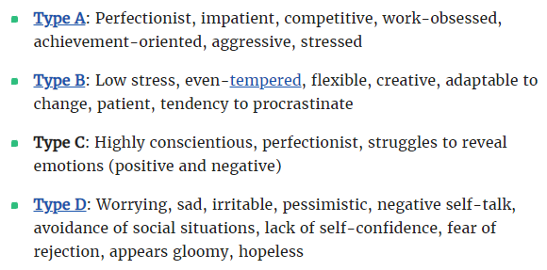
Personality
Notes:
6
6
6
6

Slide 7
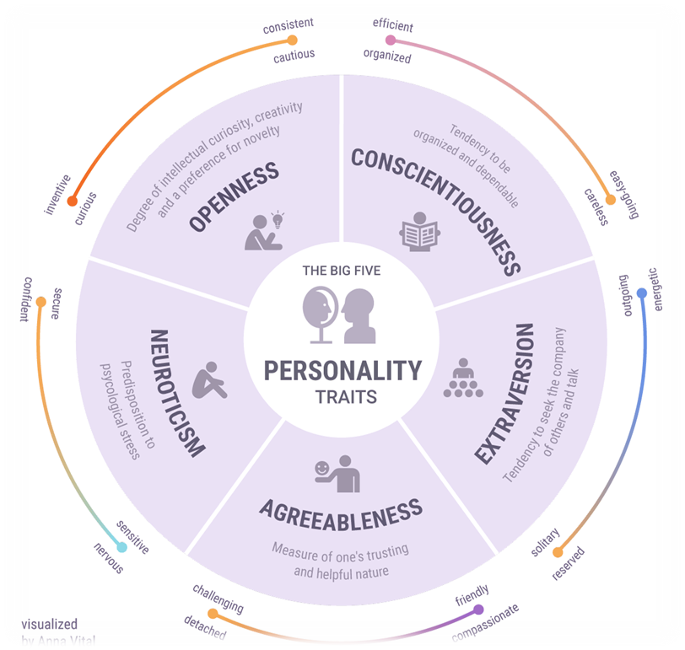
Big Five Personality Traits
Notes:
8
8
8

Slide 8
Big Five Personality Traits
Personality – Psychologists were interested in what differentiates one person from another and why we behave the way that we do.
Asking thousands of people hundreds of questions and then analyzing the data.
Using Big Five to study personality in terms of how it changes over time and how it relates to other variables.
Notes:
8
8
8

Slide 9
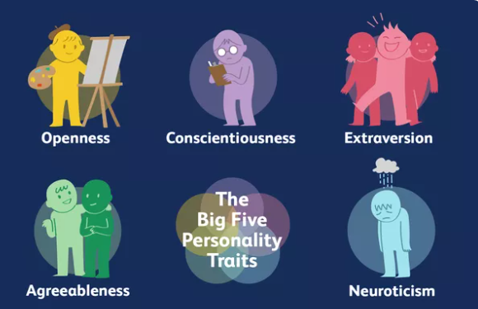
Big Five Personality Traits
Notes:
8
8
8

Slide 10
1. Openness to Experience
It is one of the “Big Five” personality factors which means being creative and open to new ideas.
This factor indicates how open mind a person is.
They have creative thinking and have flexible attitude.
Notes:
8
8
8

Slide 11
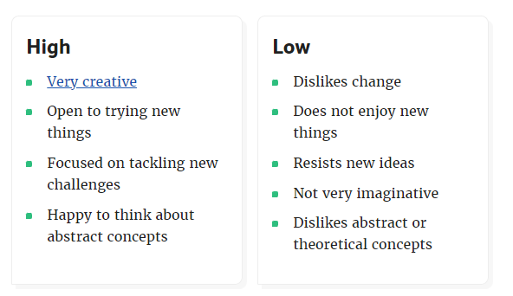
1. Openness to Experience
Notes:
8
8
8

Slide 12
2. Conscientiousness
Conscientiousness is used to describe the degree to which person is organised.
How discipline he or she is and can also describe how careful a person is in certain situation.
Notes:
8
8
8

Slide 13
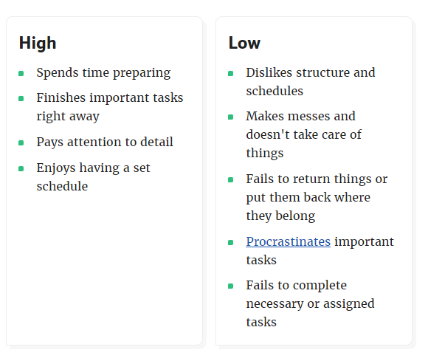
2. Conscientiousness
Notes:
8
8
8

Slide 14
3. Agreeableness
A Personality dimension that describe the individual’s propensity.
Someone with agreeableness factor is good natured cooperative and trusting.
Notes:
8
8
8

Slide 15
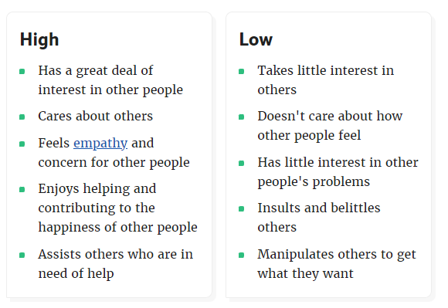
3. Agreeableness
Notes:
8
8
8

Slide 16
4. Extraversion
Extraversion is defined as a behaviour where someone enjoys being around people more than being alone.
An example of extraversion is when someone always likes to be around people and enjoys being the center of attention.
Notes:
8
8
8

Slide 17
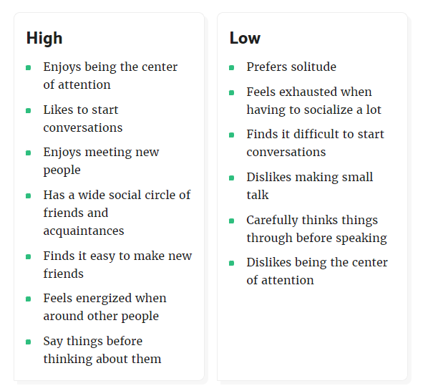
4. Extraversion
Notes:
8
8
8

Slide 18
5. Neuroticism
Is the tendency to experience negative emotions, such as anger, anxiety or depression.
It is sometimes called emotional instability.
Notes:
8
8
8

Slide 19
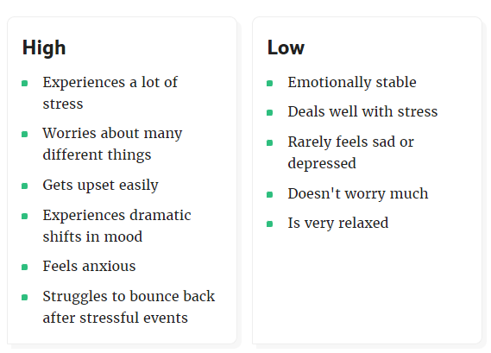
5. Neuroticism
Notes:
8
8
8

Slide 20
Personality Characteristics in Organizations
Locus of Control
Internal
External
I control what
happens to me!
People and circumstances control my fate!
Notes:
9
9
9
8

Slide 21
Personality Characteristics in Organizations
Self-Efficacy - beliefs and expectations about one’s ability to accomplish a specific task effectively
Sources of self-efficacy
  Prior experiences and prior success
  Behavior models (observing success)
  Persuasion
  Assessment of current physical & emotional capabilities
Notes:
10
10
10
9

Slide 22
Personality Characteristics in Organizations
Self-Esteem
Feelings of Self Worth
Success tends
to increase
self-esteem
Failure tends
to decrease
self-esteem
Notes:
11
11
11
10

Slide 23
Personality Characteristics in Organizations
Self-Monitoring
Behavior based on cues from people & situations
High self-monitors
  flexible: adjust behavior according to the situation and the behavior of others
  can appear unpredictable & inconsistent
Low self-monitors
  act from internal states rather than from situational cues
  show consistency
  less likely to respond to work group norms or supervisory feedback
Notes:
12
12
12
11

Slide 24
Who Is Most Likely to . . .
Low-self monitors
High-self monitors
Get promoted
Accomplish tasks, meet other’s expectations, seek out central positions in social networks
✓
Change employers
✓
Self-promote
Make a job-related geographic move
✓
Demonstrate higher levels of managerial self-awareness; base behavior on other’s cues and the situation

Slide 25
Personality Characteristics in Organizations
Positive Affect - an individual’s tendency to accentuate the positive aspects of oneself, other people, and the world in general
Negative Affect - an individual’s tendency to accentuate the negative aspects of oneself, other people, and the world in general
Notes:
13
13
13
12

Slide 26
Personality Characteristics in Organizations
A strong
situation can
overwhelm the effects
of individual personalities
by providing strong cues
for appropriate
behavior
Notes:
14
14
14
13

Slide 27

Personality Characteristics in Organizations
Strong
personalities
will dominate
in a weak
situation
Notes:
15
15
15
14

Slide 28

How is Personality Measured?
Projective Test - elicits an individual’s response to abstract stimuli
Behavioral Measures - personality assessments that involve observing an individual’s behavior in a controlled situation
Self-Report Questionnaire - assessment involving an individual’s responses to questions
Myers-Briggs Type Indicator (MBTI) - instrument measuring Jung’s theory of individual differences.
Notes:
16
16
16

Slide 29
Myers-Briggs Type Indicator
Based on Carl Jung’s work
  People are fundamentally different
  People are fundamentally alike
  People have preference combinations for extraversion/introversion, perception, judgment
Briggs & Myers developed the MBTI to understand individual differences
Notes:
17
17
17

Slide 30
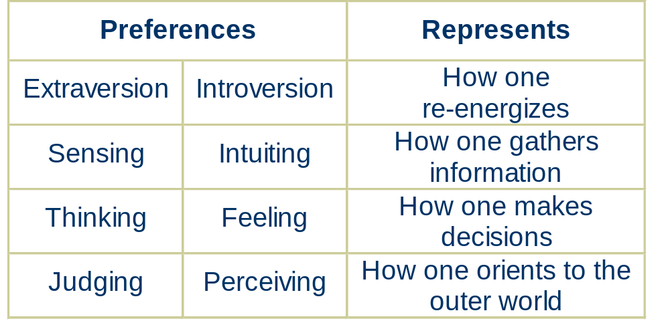
MBTI Preferences
Notes:
18
18

Slide 31
Personality Theories
Trait Theory - understand individuals by breaking down behavior patterns into observable traits
Psychodynamic Theory - emphasizes the unconscious determinants of behavior
Humanistic Theory - emphasizes individual growth and improvement
Integrative Approach - describes personality as a composite of an individual’s psychological processes
Notes:
7
7
7
7

Slide 32

Social Perception
Barriers
Selective perception
Stereotyping
First-impression error
Projection
Self-fulfilling prophecies
Social Perception -
interpreting information about another person
Notes:
22
22

Slide 33
Social Perception
Perceiver Characteristics
Familiarity with target
Attitudes/Mood
Self-Concept
Cognitive structure
Target Characteristics
Physical appearance
Verbal communication
Nonverbal cues
Intentions
Social Perception -
interpreting information about another person
Barriers
Situational Characteristics
Interaction context
Strength of situational cues
Notes:
22
22

Slide 34
Impression Management
Impression Management - process by which individuals try to control the impression others have of them
  Name dropping
  Appearance
  Self-description
  Flattery
  Favors
  Agreement with opinion
Notes:
24
24

Slide 35
Attribution Theory
Attribution theory - explains how individuals pinpoint the causes of their own behavior or that of others
Information cues for attribution information gathering
  consensus
  distinctiveness
  consistency
Notes:
25
25

Slide 36
Attribution Biases
Fundamental Attribution Error - tendency to make attributions to internal causes when focusing on someone else’s behavior
Self-serving Bias - tendency to attribute one’s own successes to internal causes and one’s failures to external causes
Notes:
25
25

